Slide 1
COVID DATA ANALYSIS USING AWS
SAI KUMAR

Slide 2
ABSTRACT:
The project is to perform data analysis on Covid data across the globe and extract the meaningful information from the dataset which will help in taking quick and informed decision so that will help in preventing further spread of Coved virus.

Slide 3
TECHNOLOGIES USED:
AWS Glue
SparkSQL
Redshift
AWS S3
SparkSQL
Crawler
AWS Lambda
PySpark

Slide 4
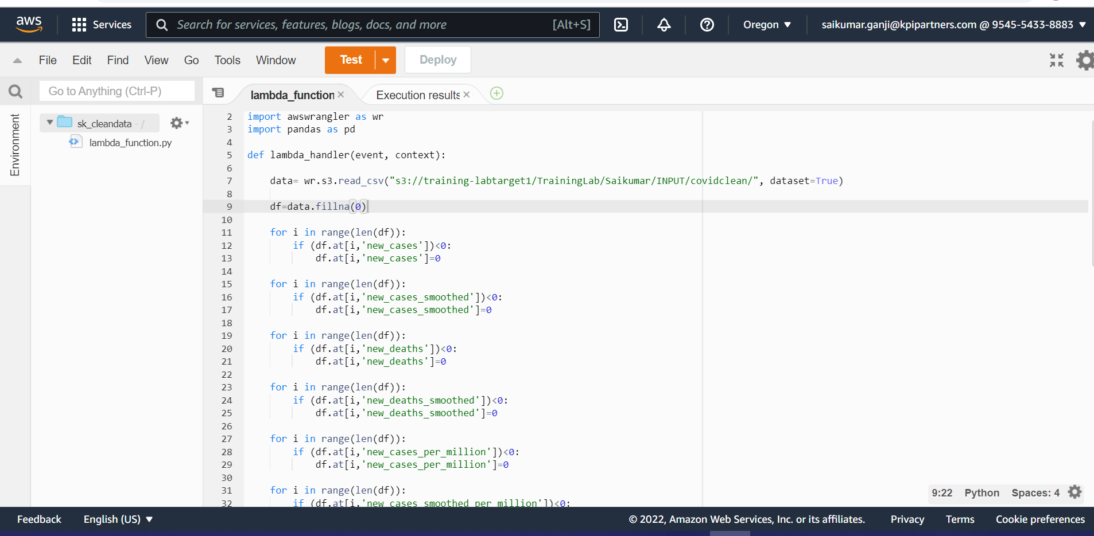
Problem Statements:
1.Clean and transform data for processing

Slide 5
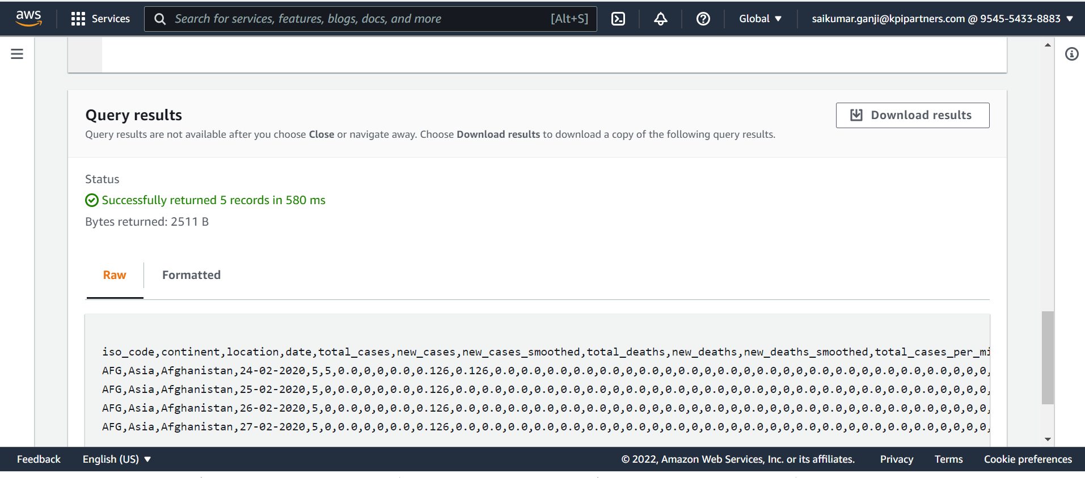

Slide 6
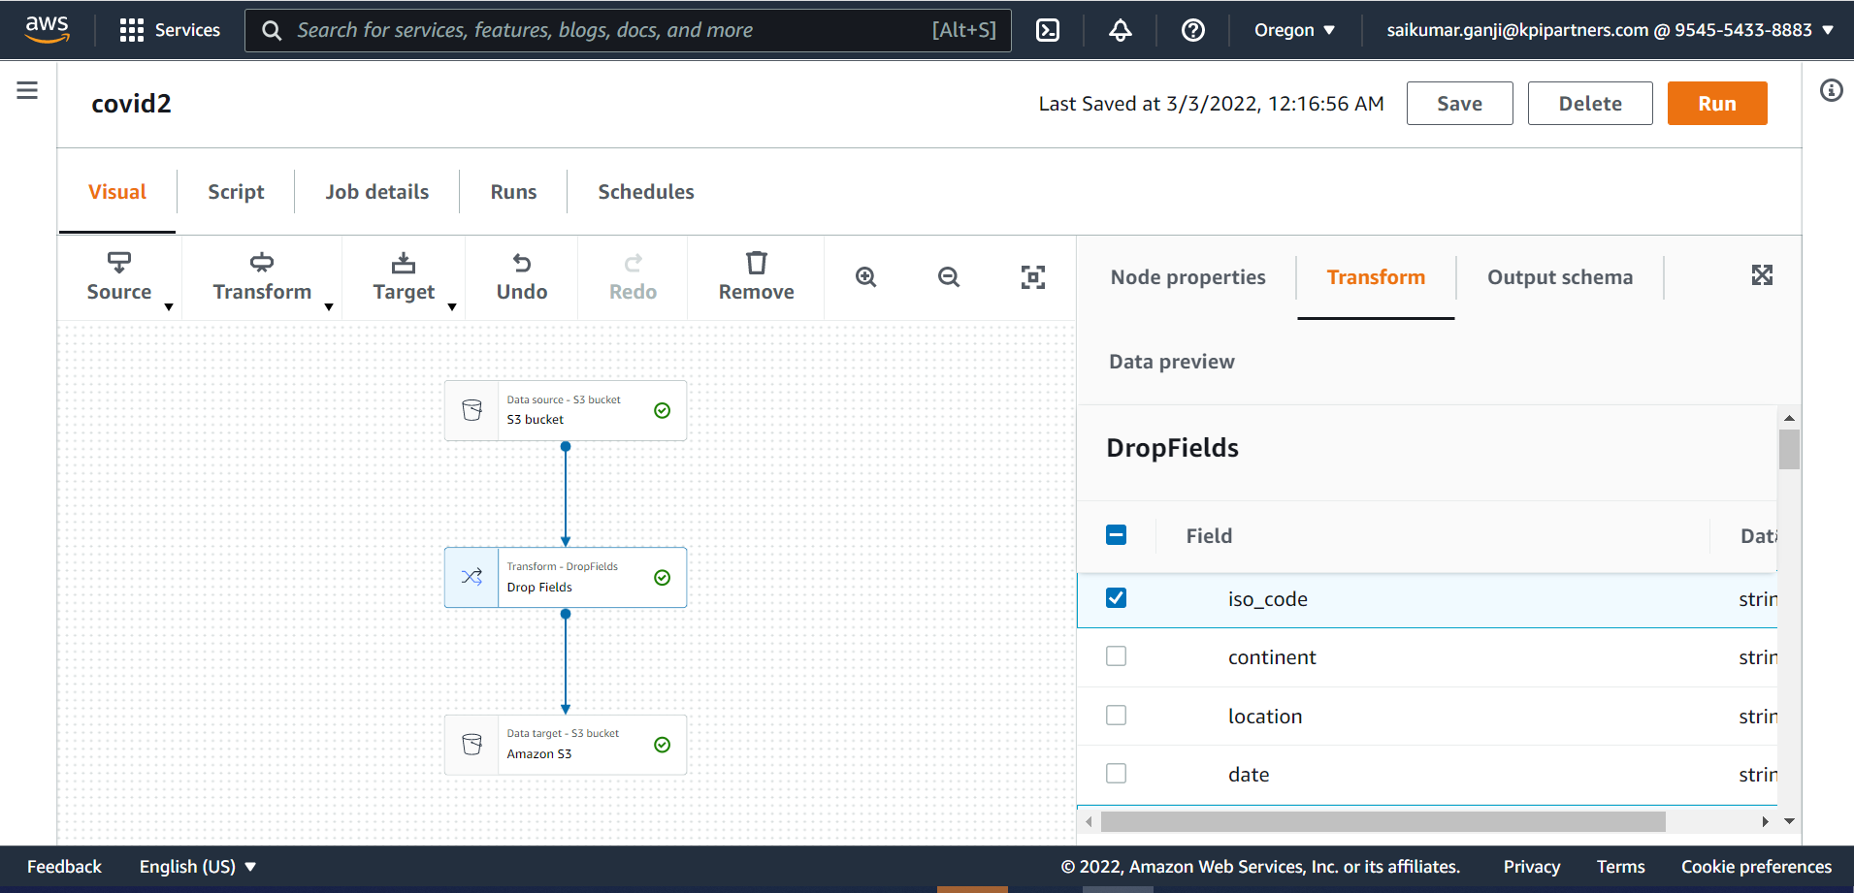
2. ETL operations on dataset:

Slide 7
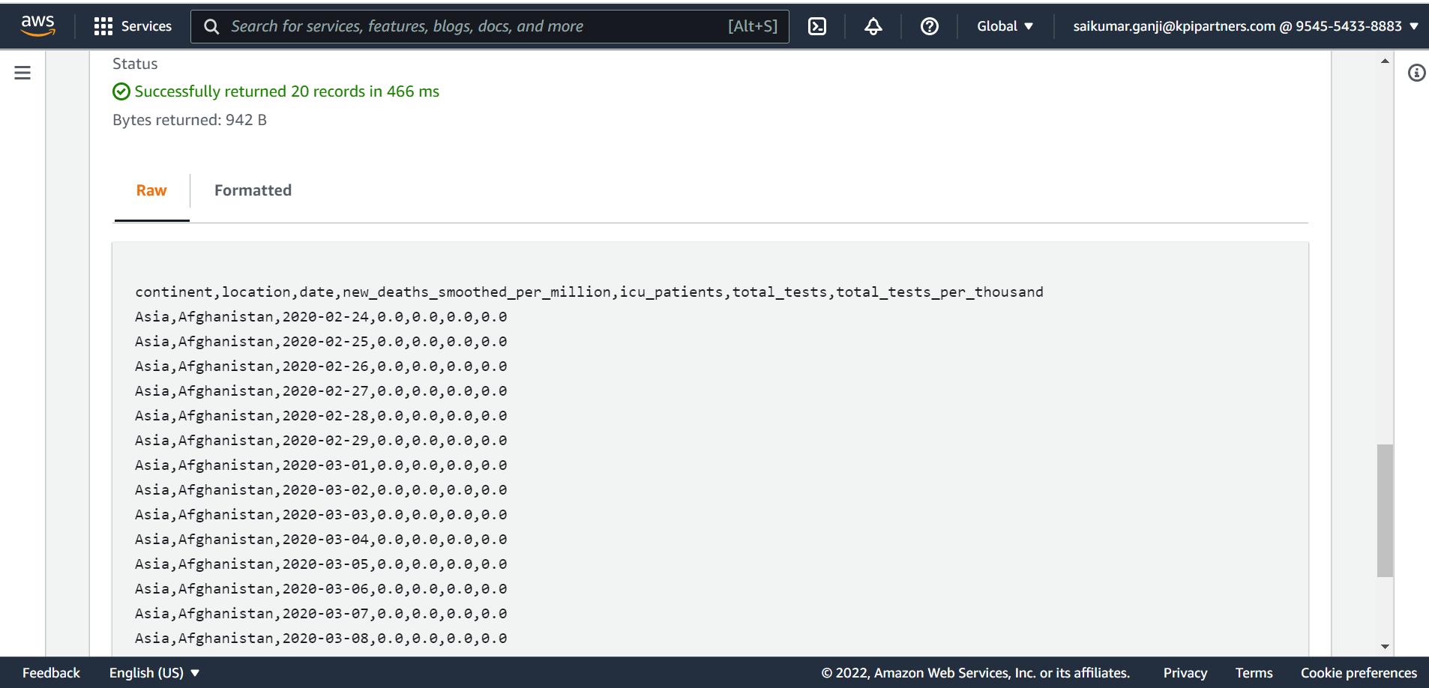

Slide 8
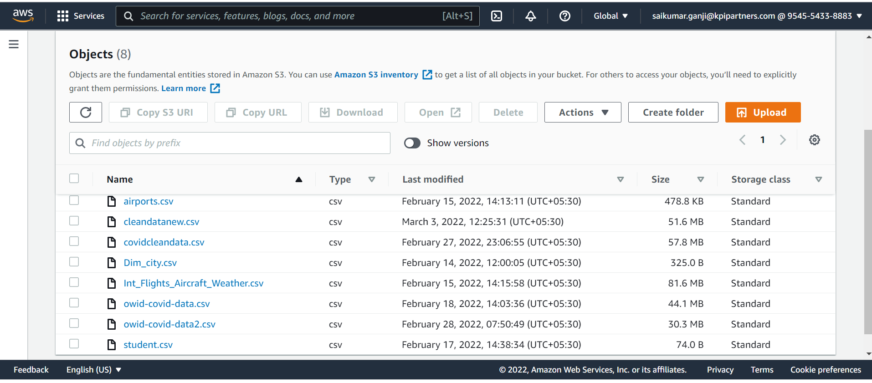
3. Storing the modified data in AWS:

Slide 10
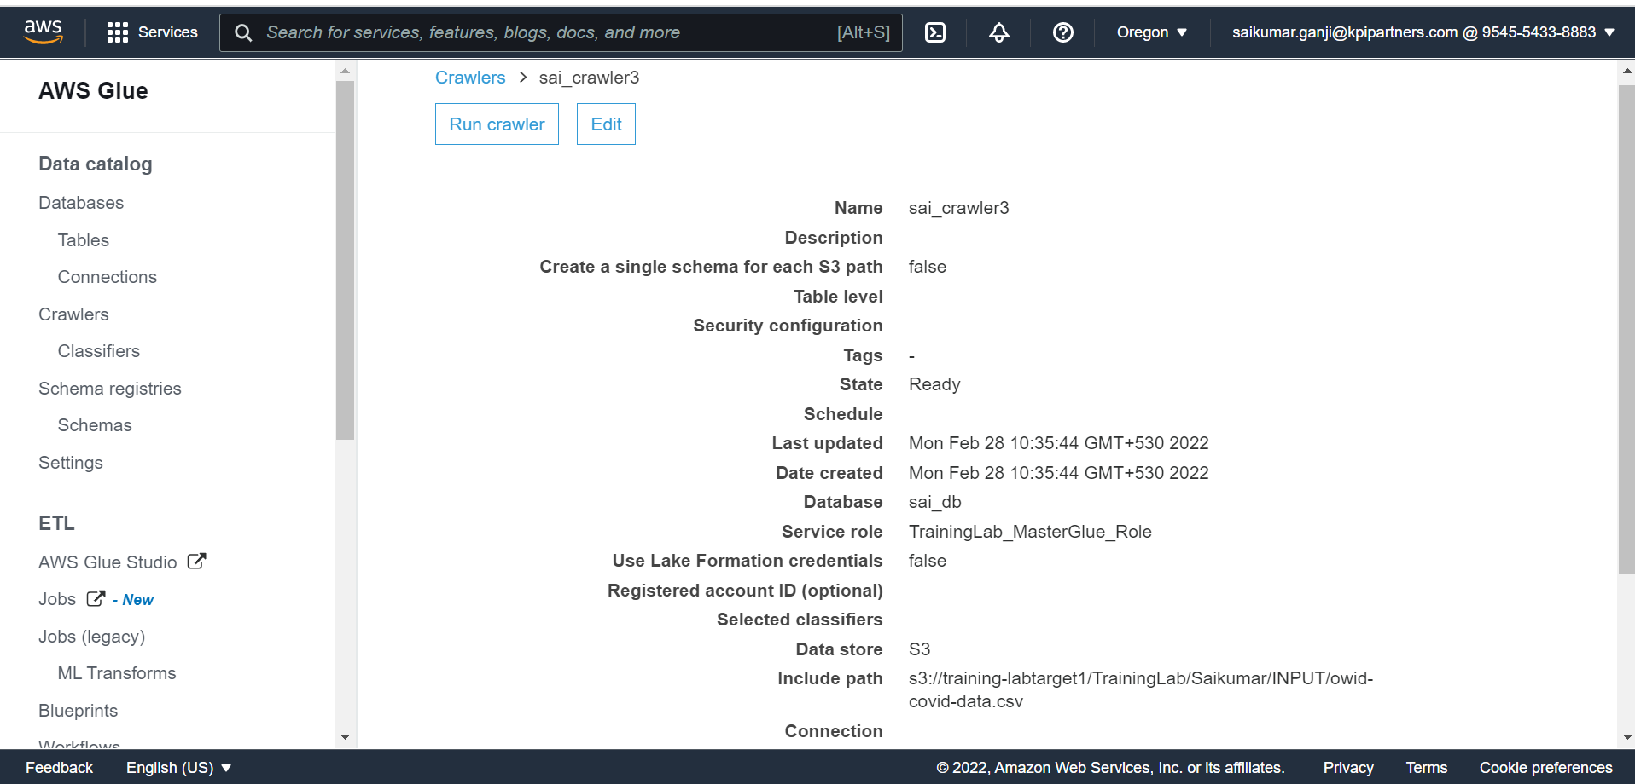
4.Display total cases ,new cases ,recovered cases and deaths

Slide 11
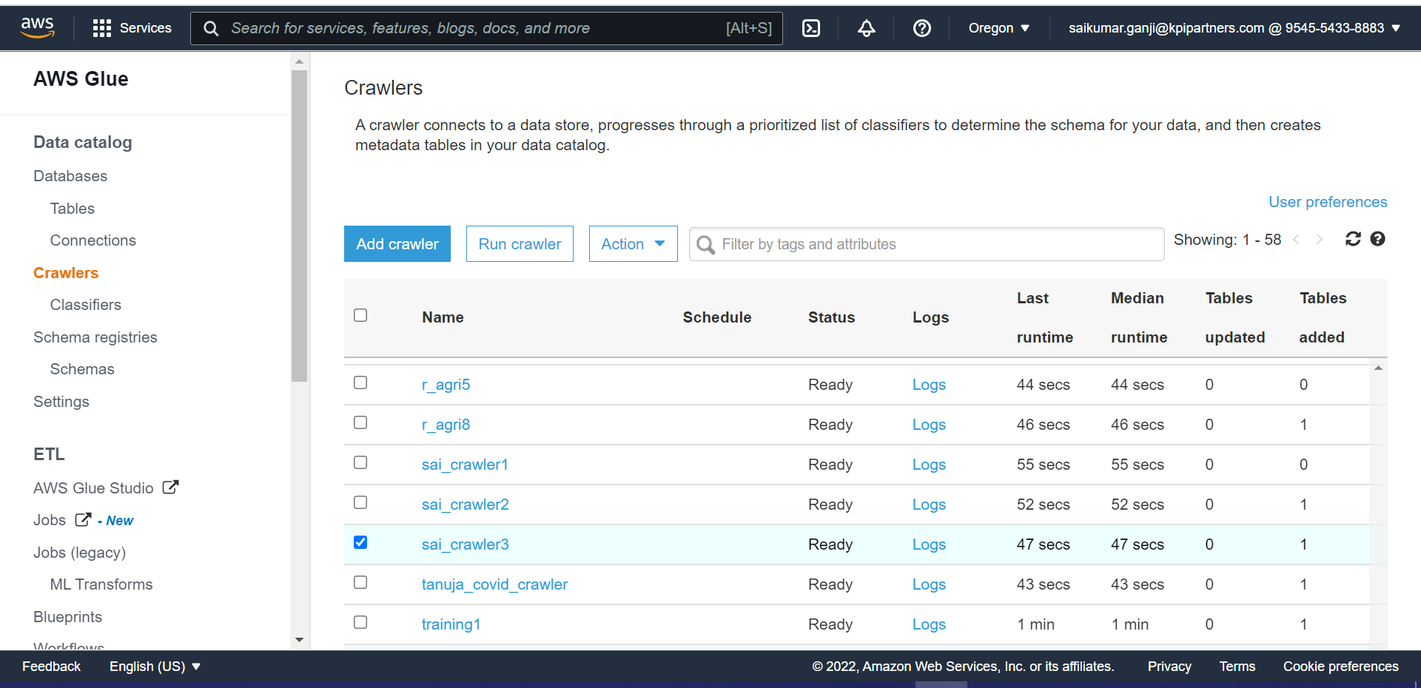

Slide 12
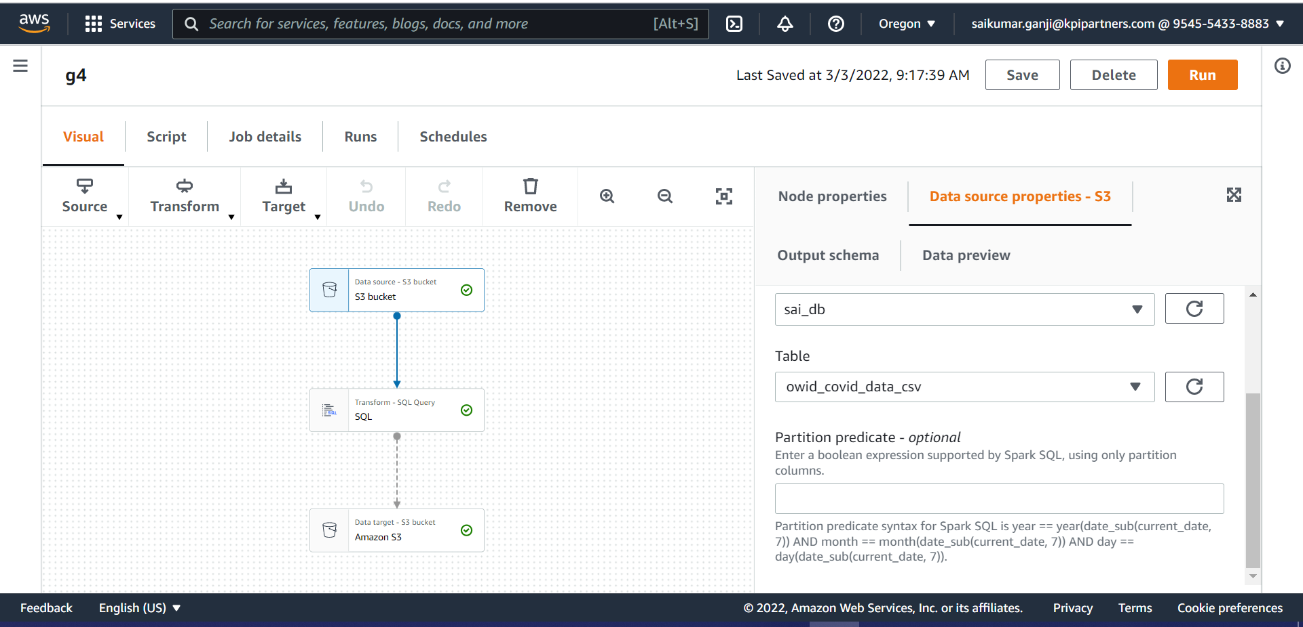
4.Display total cases ,new cases ,recovered cases and deaths

Slide 13
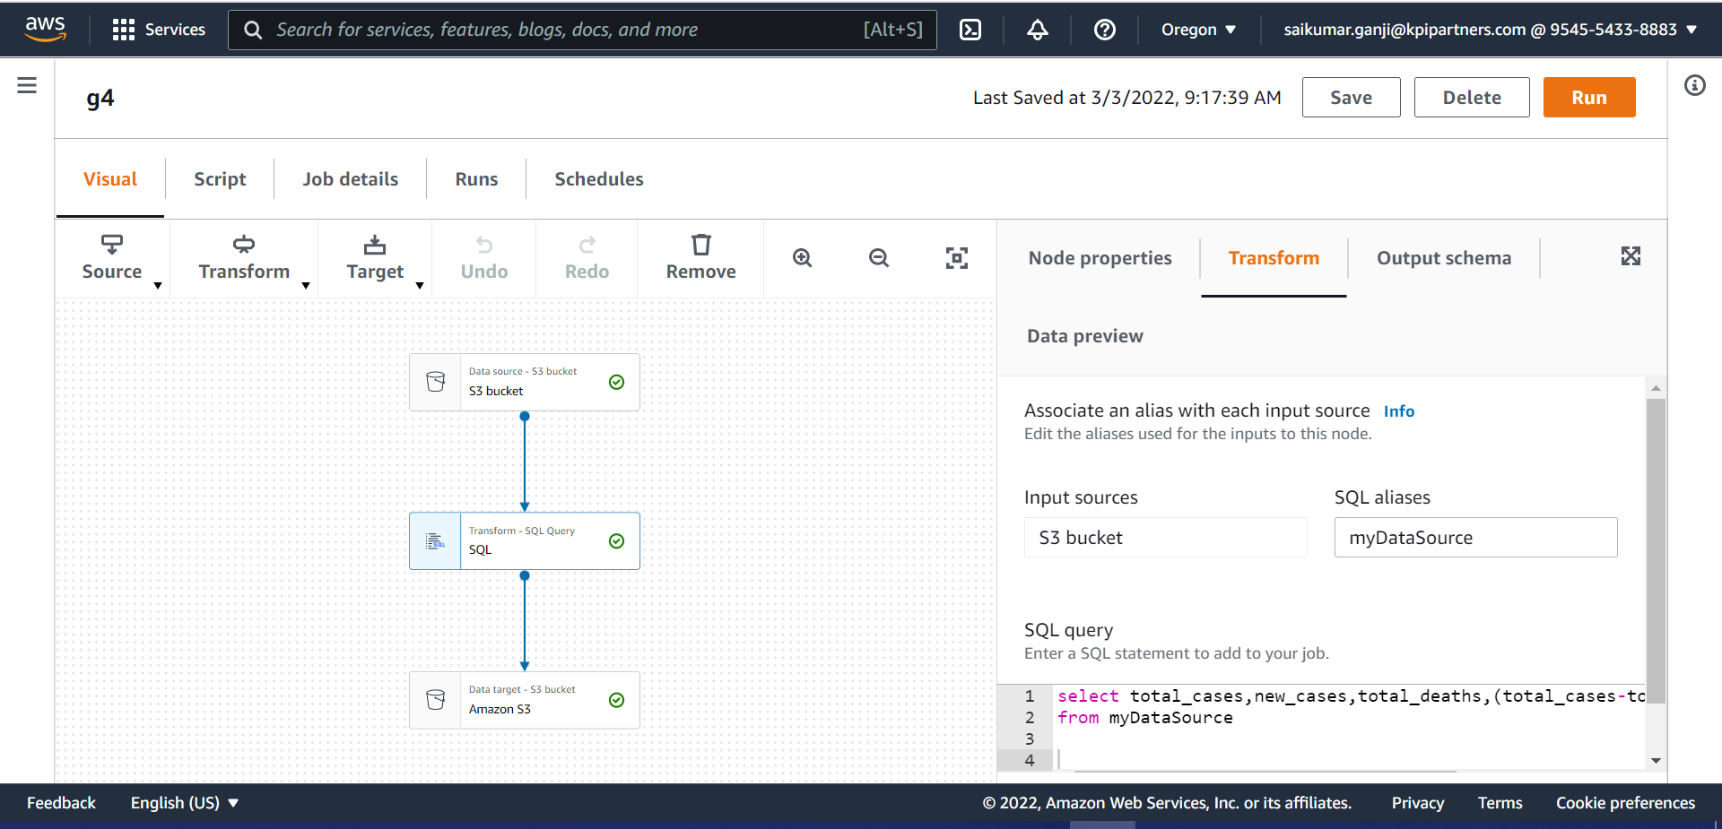

Slide 14
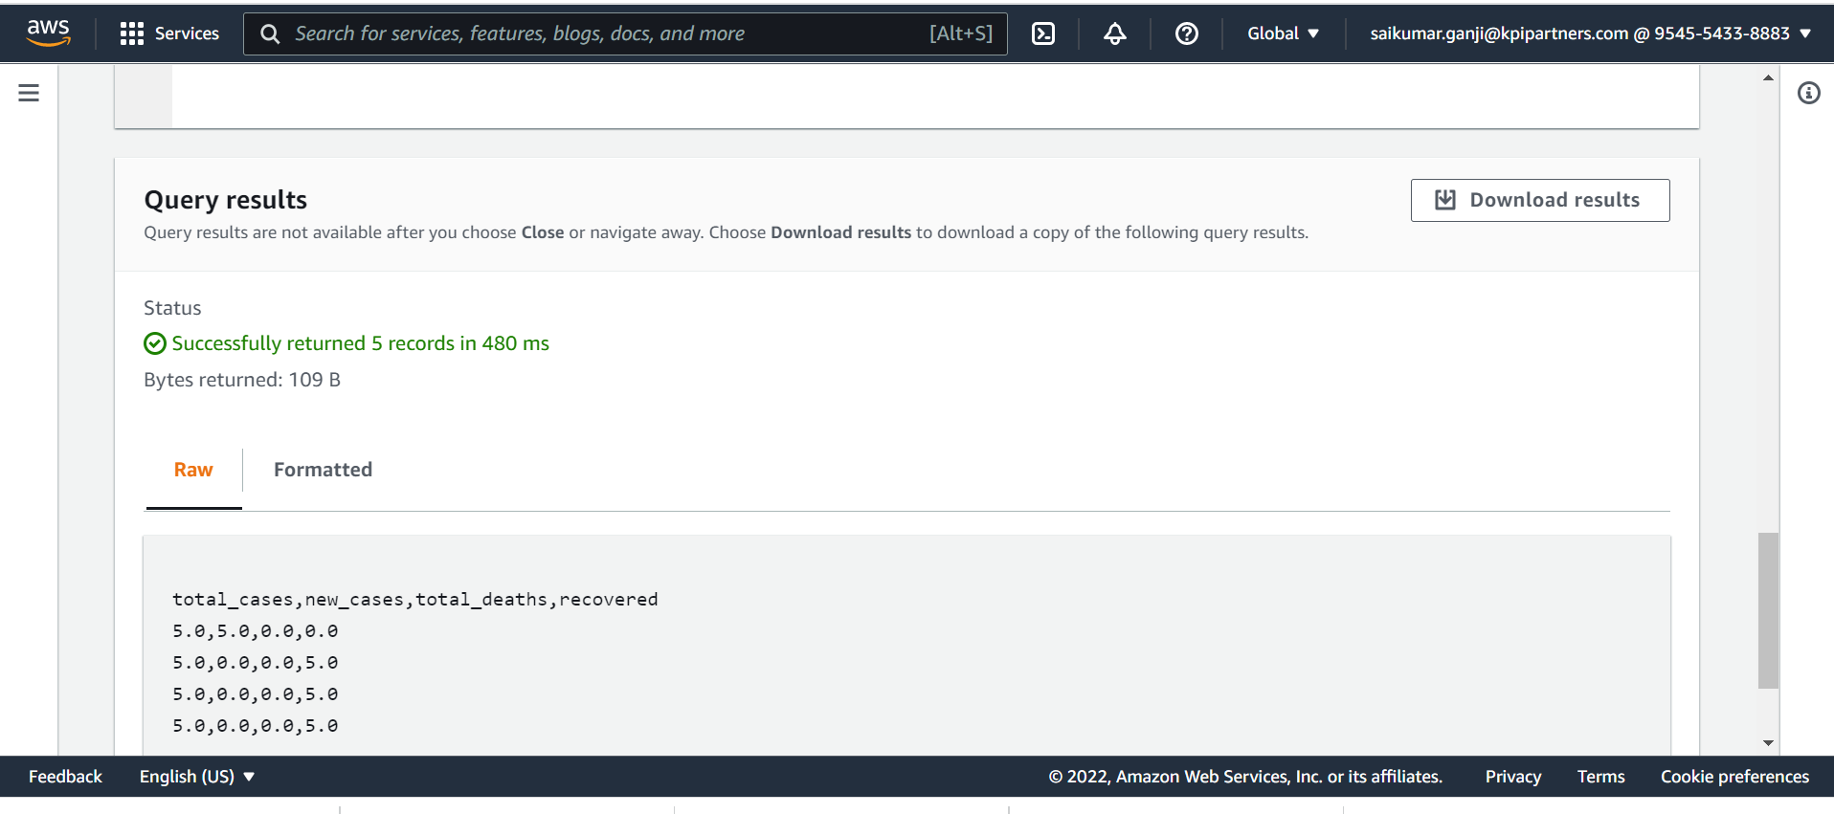

Slide 15
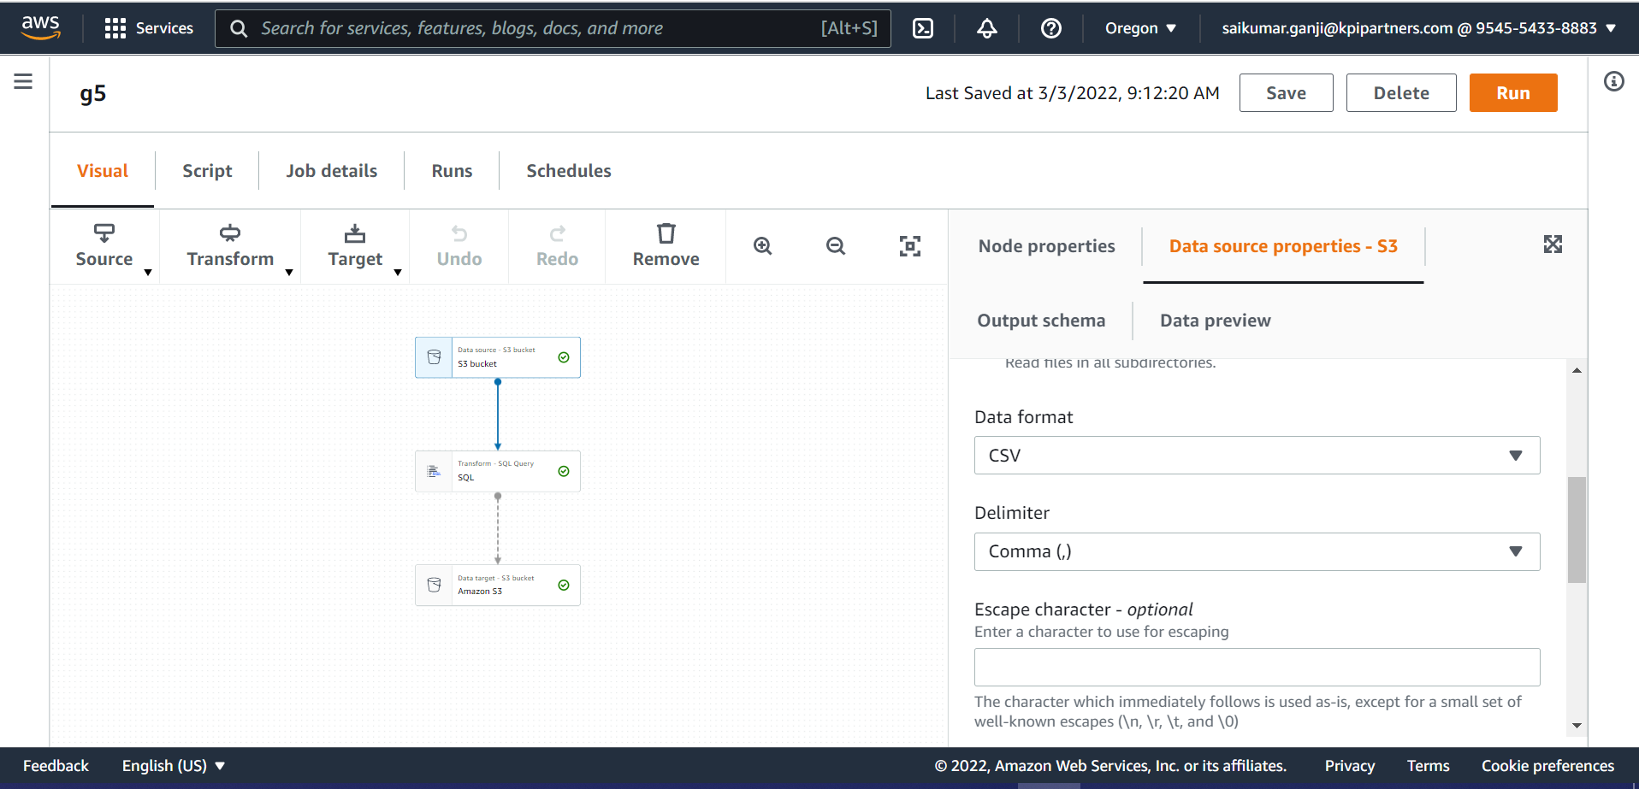
5. Which country in Distinct WHO region highest cases in till date.

Slide 16
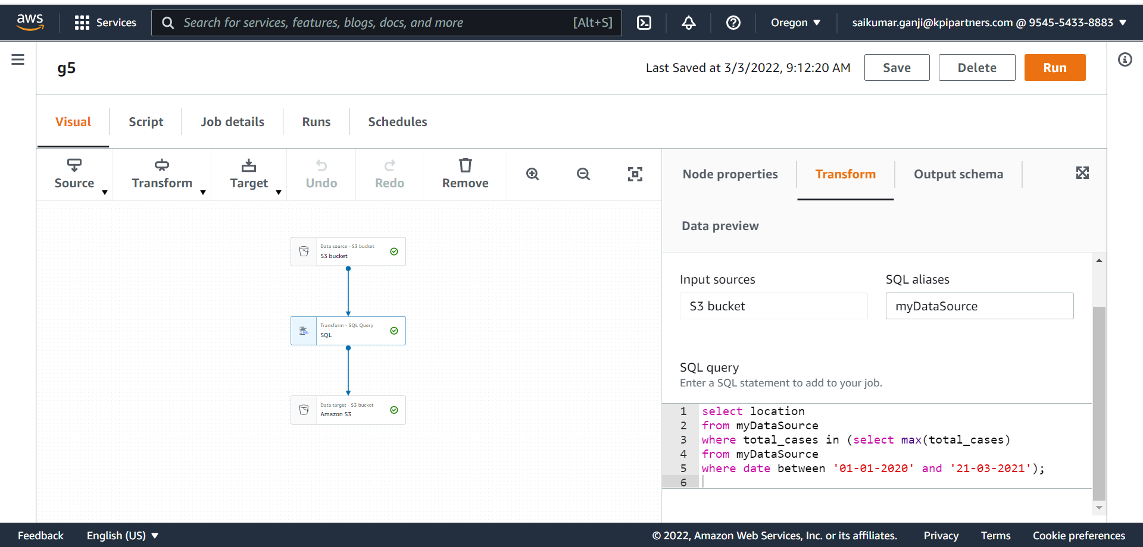

Slide 17
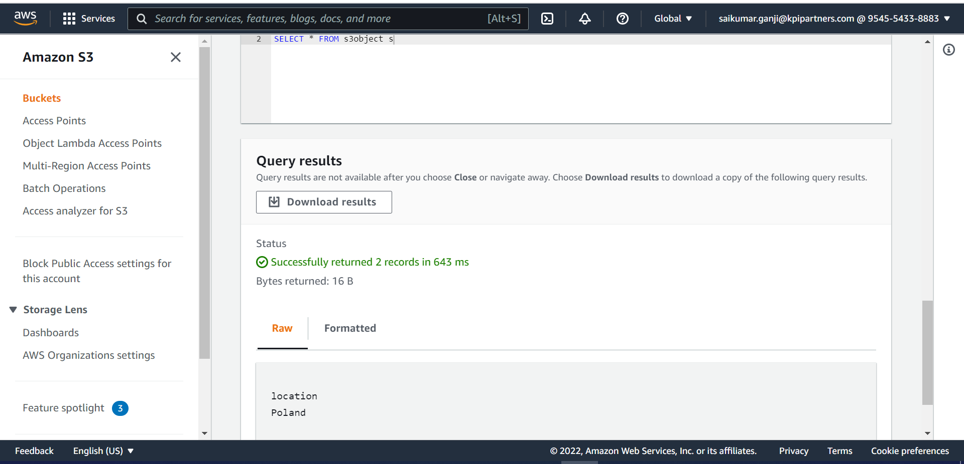

Slide 18
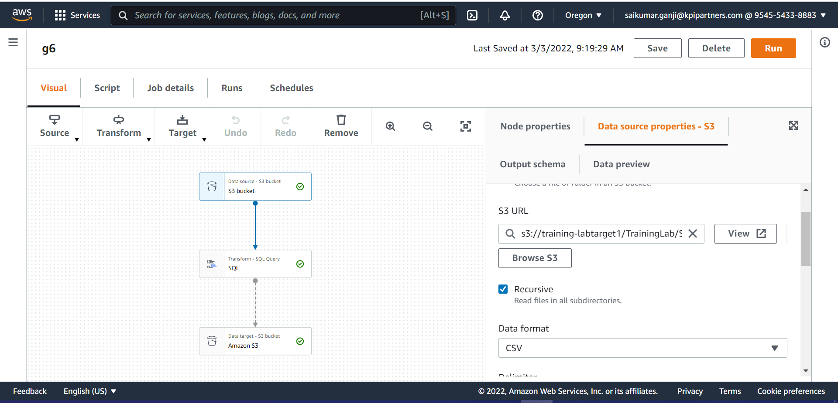
6. Total no of confirmed cases over between a certain date.

Slide 19
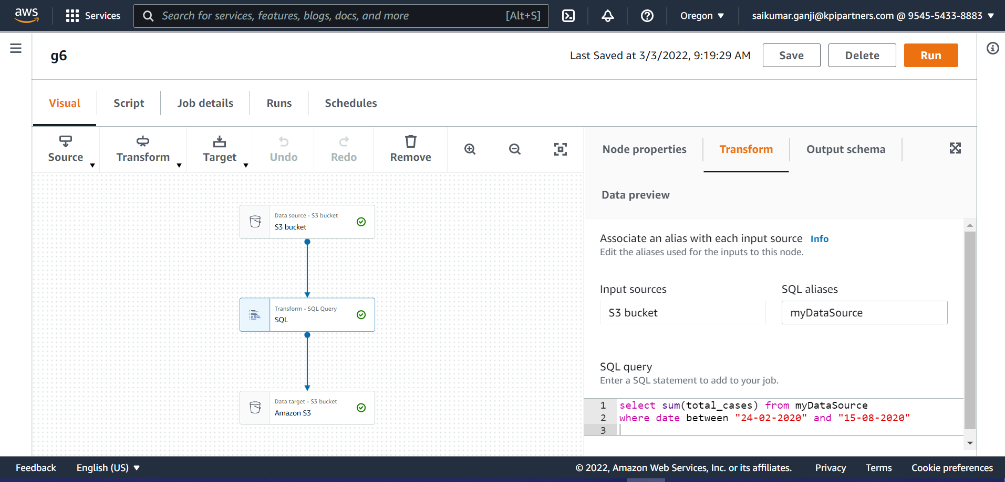

Slide 20
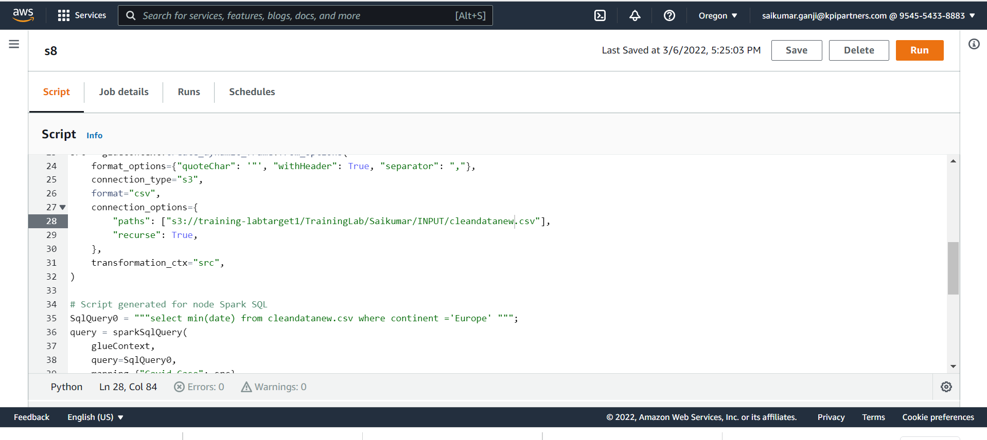
7.Date of first confirmed case in a particular region.

Slide 21
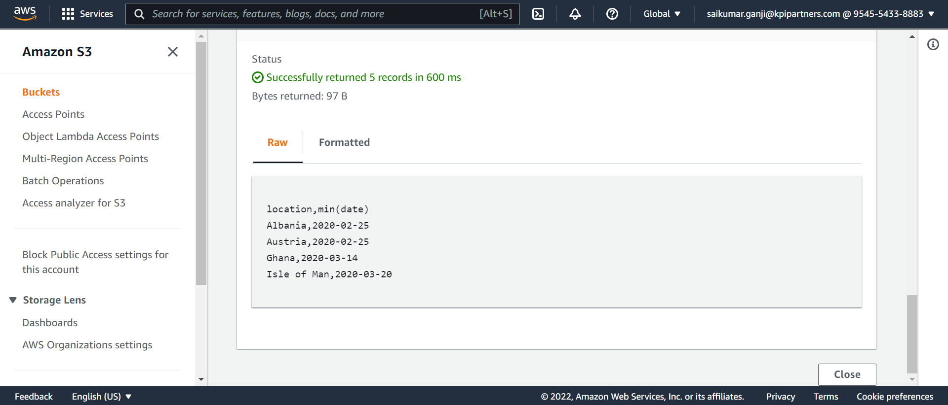

Slide 22
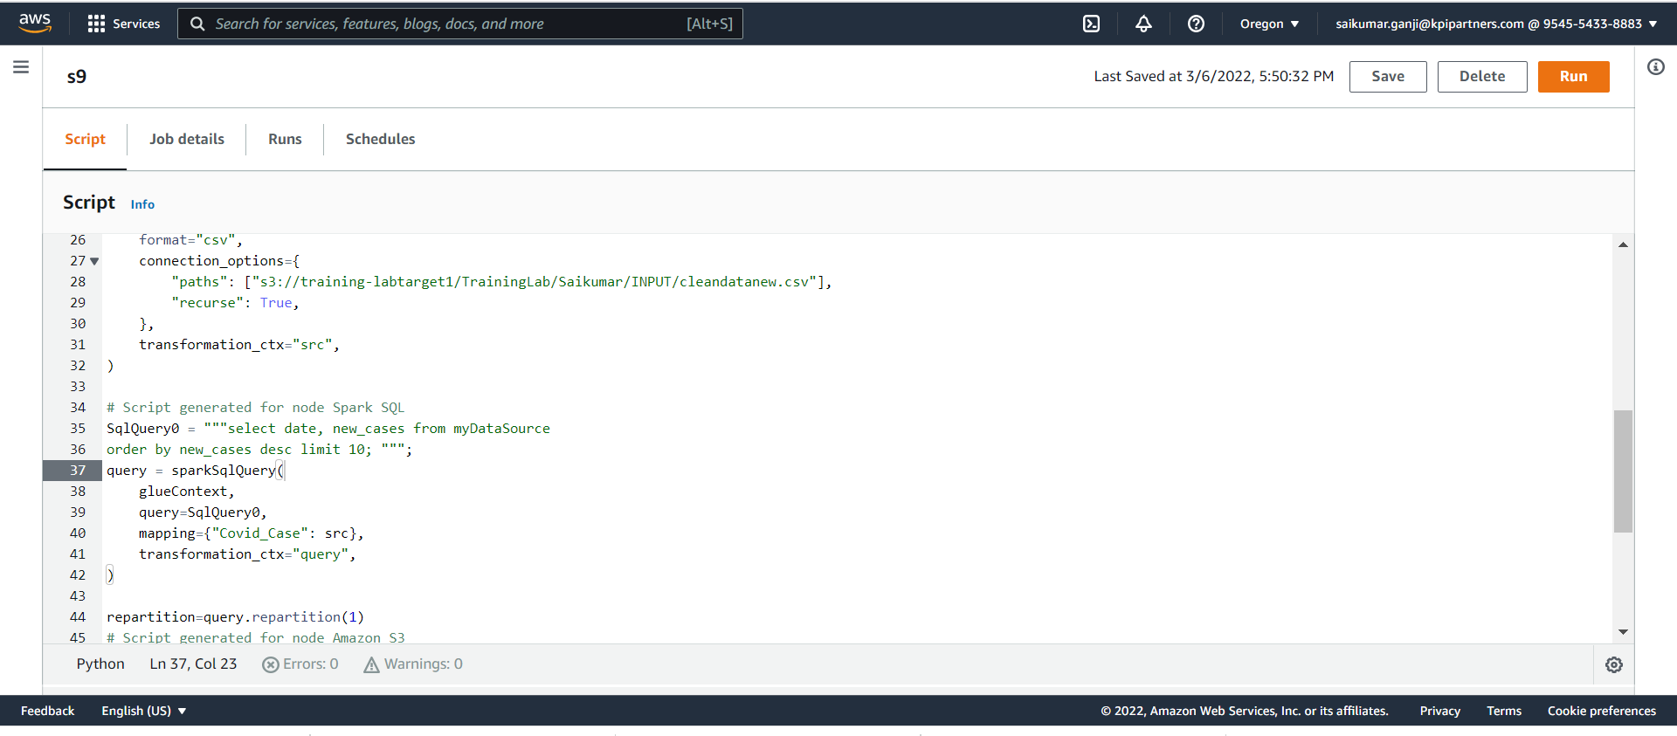
8.Date on which max no. cases were reported in a country.

Slide 23
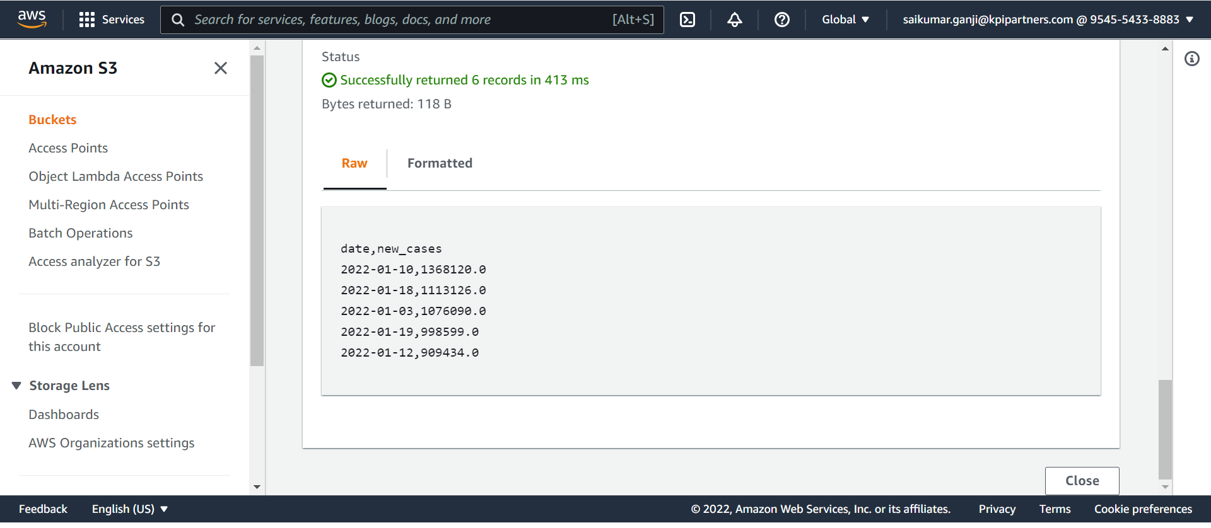

Slide 24
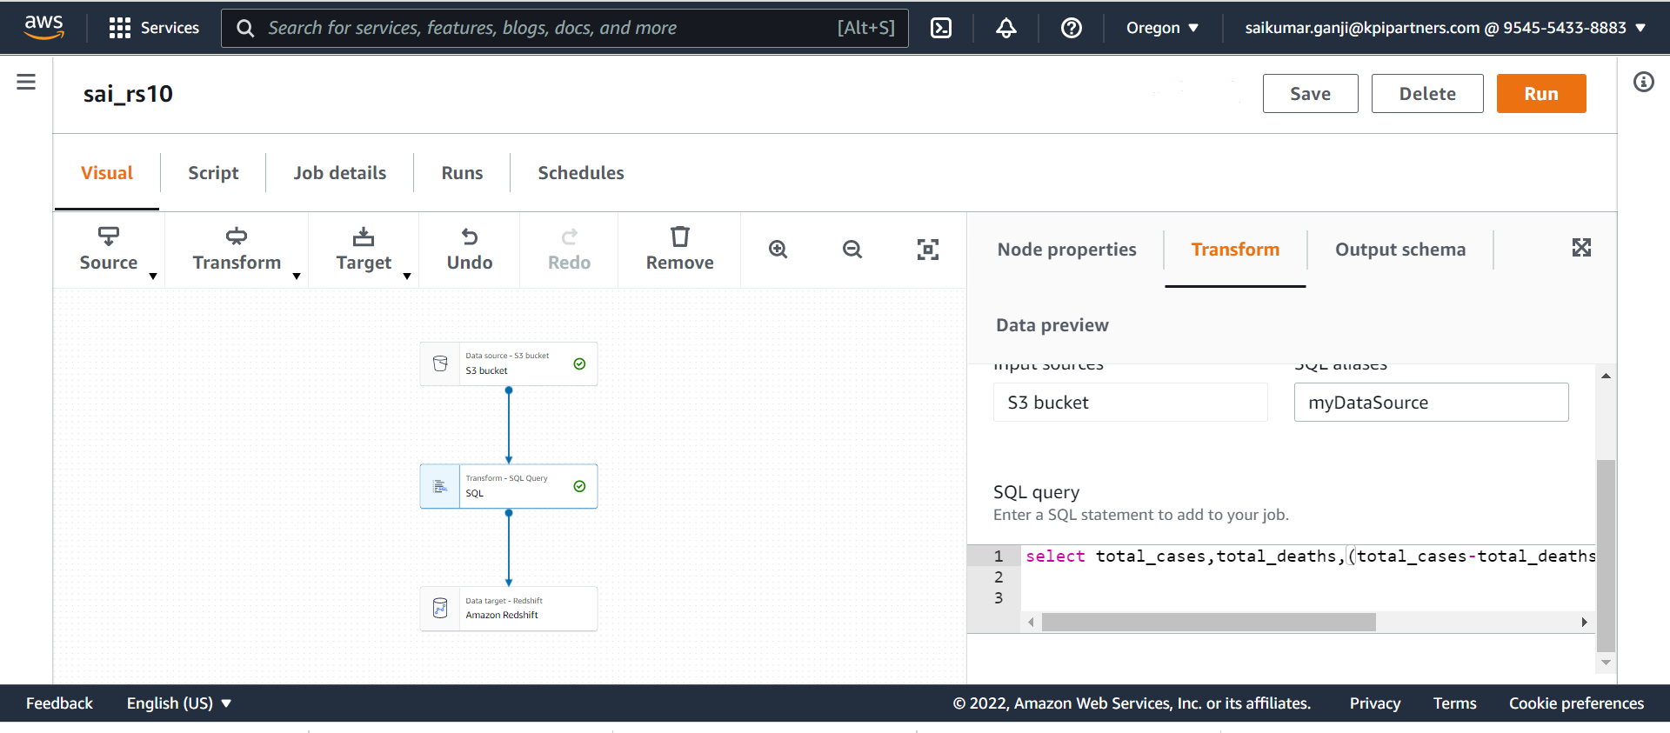
9.Line chart showing total cases, deaths &recoveries of a particular country

Slide 25
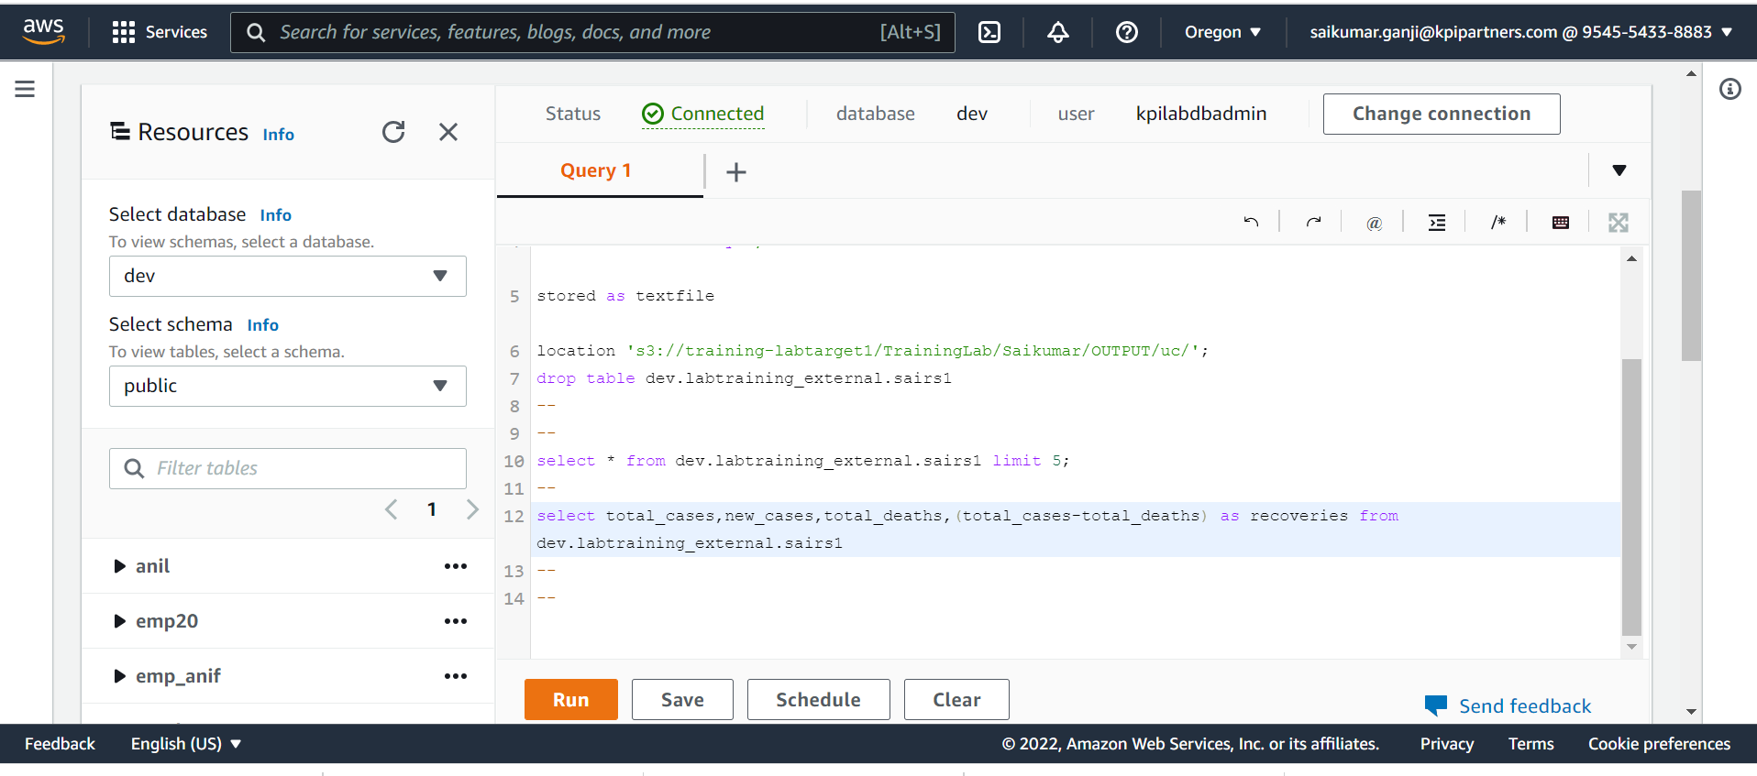

Slide 27
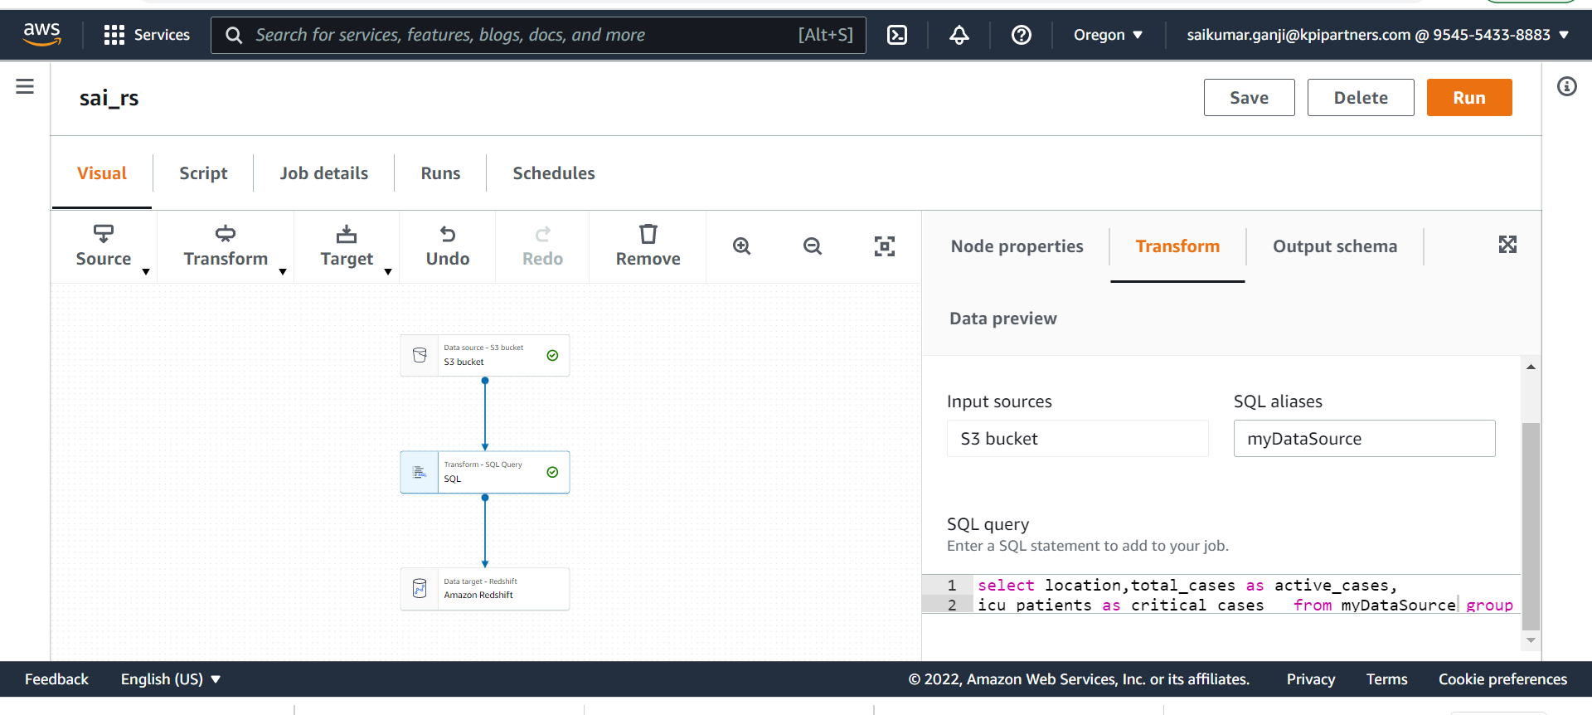
10.No. of active cases vs critical cases of a country.

Slide 28
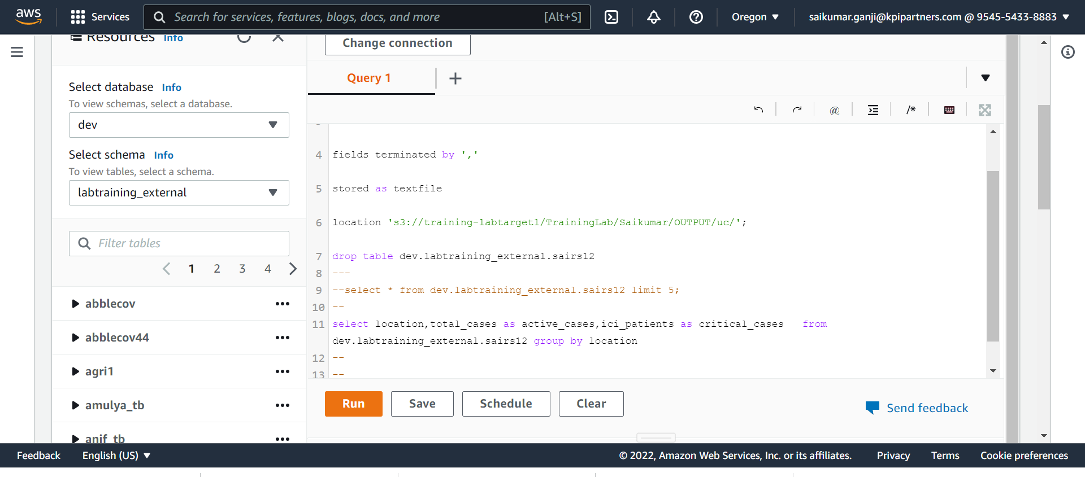

Slide 29
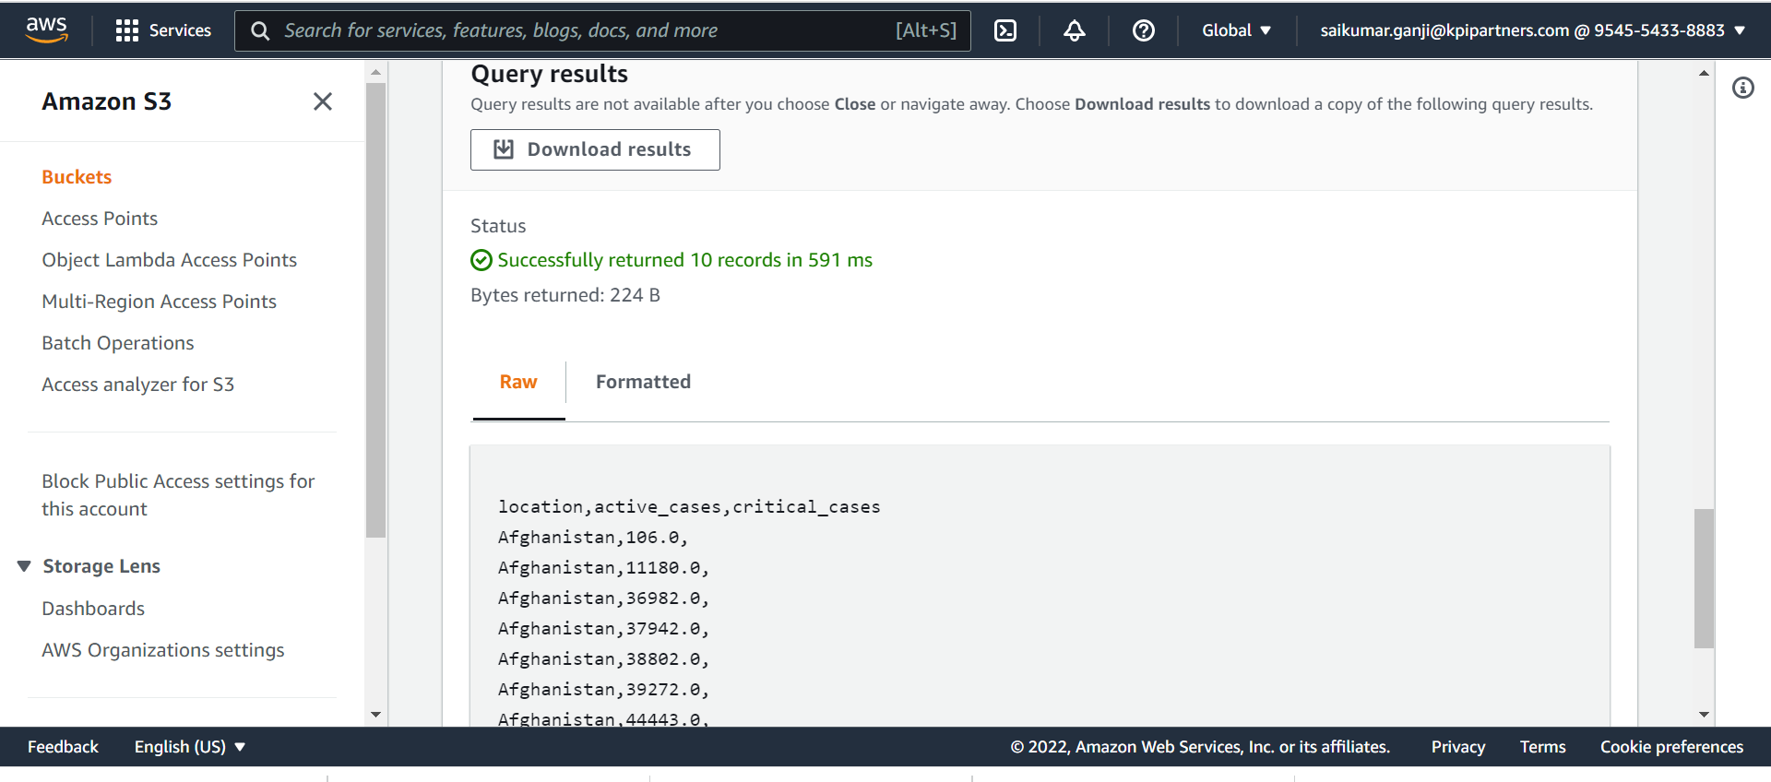

Slide 30
THANK YOU

